Slide 1
Computer Vision:-AI VIOLENCE DETECTION SYSTEM

Slide 2
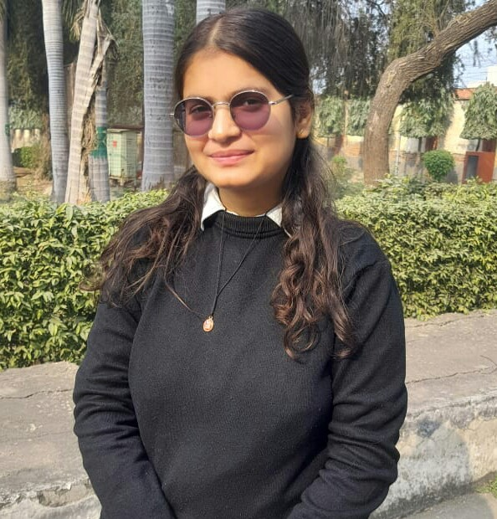



Smart Surveillance Squad
Student Name
Kashish Gautam
Bhoomi
Ashi
Khushi Kashyap

Slide 3
Workload Division
Composition and Workload Division
Kashish Gautam - Developed the complete coding and designed the full Streamlit web dashboard, and also prepared the entire PPT presentation.
Bhoomi – Prepared the complete project documentation and handled video editing Creation.
Ashi – Contributed to coding tasks and provided support in documentation preparation.
Khushi Kashyap – Assisted in documentation work and contributed to the preparation of the PowerPoint presentation.

Slide 4
The Background
A CCTV surveillance style background can also be used, featuring faint camera overlays, control room screens, and HUD (heads-up display) elements to emphasize security monitoring. This makes the presentation more realistic and impactful, especially for a violence detection system.
Another option is an AI neural network background with glowing nodes and digital connections, which highlights the machine learning aspect of the project. This works well if you want to focus more on the AI/ML technology behind the system.
Overall, the best choice is a dark cyber-security theme with cyan accents, as it balances both AI intelligence and surveillance security, making your PPT look modern, clean, and professional.

Slide 5
Proposed Solution
The proposed solution is an AI-based real-time violence detection system that analyzes CCTV or video footage using computer vision. It detects abnormal activity based on motion intensity and triggers instant alerts when a threat is identified. The results are displayed on an interactive Streamlit dashboard with live video monitoring and analytics, helping improve surveillance efficiency and public safety.
Overall, the proposed solution aims to reduce dependence on human monitoring, improve response time to critical situations, and provide a scalable, intelligent, and real-time surveillance system for enhanced public safety.

Slide 6
Solution Design
AI-based real-time violence detection system using computer vision
Video input from CCTV or uploaded files
Frame-by-frame processing using OpenCV
Frames converted to grayscale for analysis
Motion intensity score calculated for each frame
Threshold-based classification (Safe / Violence detected)
Real-time alerts displayed on Streamlit dashboard
Interactive UI with live video monitoring panel
Analytics using Plotly (line, pie, radar, scatter charts)
Activity logs and system status monitoring
Designed for fast response and improved surveillance efficiency

Slide 7
Technology Stack & Requirements
Technology Stack:-
Programming Language: Python
Frontend Framework: Streamlit
Computer Vision Library: OpenCV
Data Handling: Pandas
Data Visualization: Plotly
Temporary File Handling: Tempfile
System Requirements:-
Python 3.x installed
VS Code / PyCharm / Jupyter environment
Webcam or CCTV video input
Minimum 4GB RAM
Windows/Linux operating system
Required Python libraries installed:
streamlit
opencv-python
pandas
plotly
Installation Command
pip install streamlit opencv-python pandas plotly

Slide 8

Innovative Idea
AI-powered real-time violence detection for smart surveillance.
Automatic threat detection without continuous human monitoring.
Interactive dashboard with live alerts and analytics.
Real-time visualization of threat trends and security status.
Smart alert system for faster emergency response.
Combines Computer Vision, AI, and Data. Analytics in one platform.
Can be integrated with smart cities, public security systems, and CCTV networks.
Scalable solution for schools, malls, offices, railway stations, and public areas .

Slide 9
Results / Outcomes / Analysis
Successfully detected high-motion and suspicious activities in video footage.
Generated real-time violence alerts on the dashboard.
Displayed live surveillance monitoring with detection highlights.
Produced interactive analytics using line, pie, radar, and scatter charts.
Improved monitoring efficiency through automated detection.
Achieved smooth dashboard performance with real-time visualization.
Demonstrated the potential of AI and computer vision in smart surveillance systems.
Helped reduce dependency on continuous human monitoring for security analysis

Slide 10

Limitations
Detection is based mainly on motion intensity, not deep learning models .
May generate false alerts in crowded or highly active environments .
Accuracy depends on video quality and lighting conditions.
Cannot identify specific individuals or objects .
Requires continuous video input for real-time monitoring.
Limited performance on low-end systems with heavy video processing.
Does not include advanced AI models like CNN or LSTM for precise violence recognition.
Internet/cloud integration and mobile alert features are not implemented yet.

Slide 11

Future Enhancements/Scope
Integrate Deep Learning models (CNN, LSTM, YOLO) for accurate violence detection.
Add face recognition and person tracking features .
Enable real-time mobile and email alert notifications.
Integrate cloud storage and remote monitoring system
Support multiple CCTV cameras simultaneously.
Improve detection accuracy in low-light and crowded environments .
Deploy the system for smart cities, schools, malls, and public transport security .
Add audio-based threat detection and emergency response integration .
Develop a fully automated AI surveillance system with predictive analytics .

Slide 12
(GITHUB LINK) https://github.com/KashishGautam31/Computer-Vision--AI-VIOLENCE-DETECTION-SYSTEM

Slide 13
Thank You

